Slide 1

Arrays and OOPs in Java Programming
This presentation explores the fundamentals of arrays and object-oriented programming (OOP) in the Java programming language, covering key concepts, examples, and real-world applications.

Slide 2
Introduction to Arrays
What are Arrays?
Why Use Arrays?
Arrays are a fundamental data structure in programming, providing a way to store a fixed-size collection of elements of the same data type.
Arrays are used to organize and access related data efficiently, simplifying tasks such as data manipulation, iteration, and search operations.

Slide 3

Array Declarations and Initialization
1
Declaration
2
Initialization
Declare an array by specifying its data type and name, followed by square brackets.
Initialize an array by assigning values to its elements using curly braces.

Slide 4
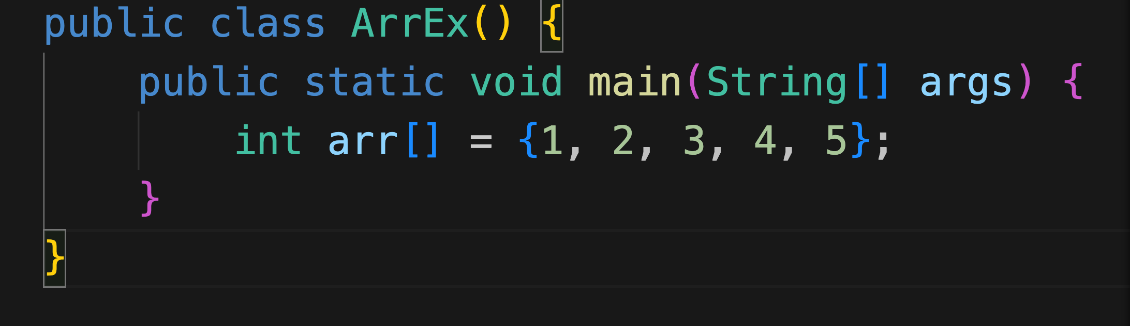
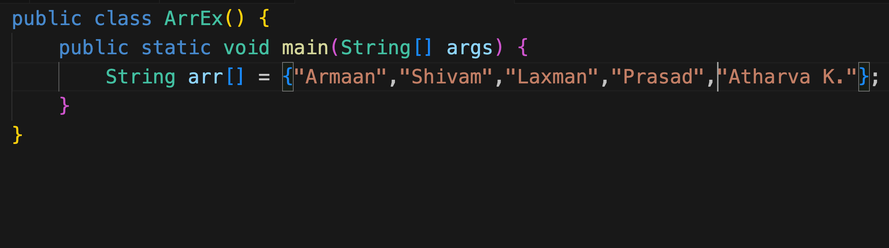
EXAMPLES OF ARRAY DECLARATION

Slide 5
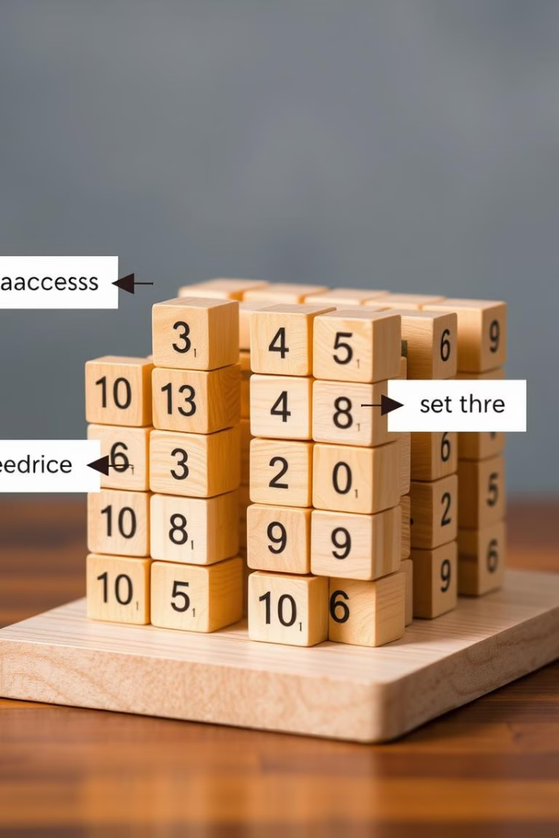



Array Operations (Accessing, Modifying, Searching)
Accessing
Modifying
Retrieve the value of an element at a specific index.
Change the value of an element at a particular index.
Searching
Locate a specific element within the array.

Slide 6
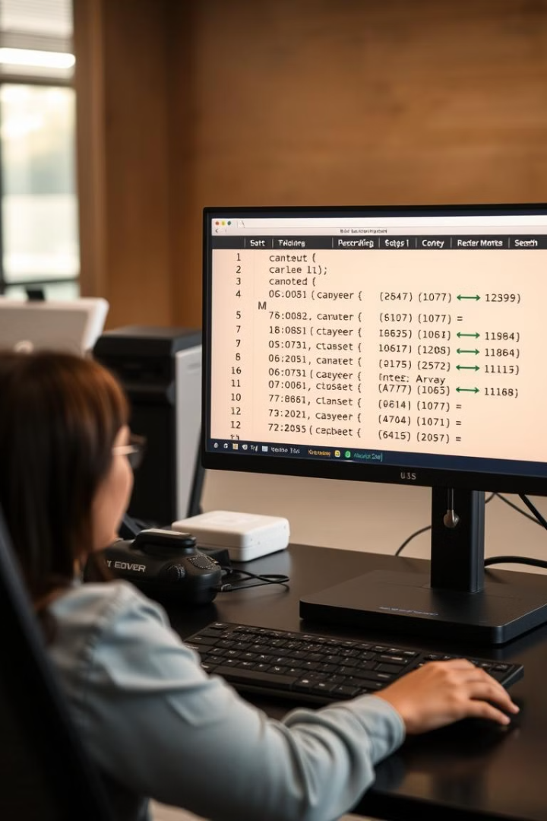
Array Sorting and Searching Algorithms
1
Sorting
Algorithms like bubble sort, insertion sort, and merge sort organize array elements in a specific order.
2
Searching
Algorithms like linear search and binary search help efficiently find specific elements within a sorted array.

Slide 7



Introduction to Object-Oriented Programming (OOP)
OOP
1
A programming paradigm that structures code around objects, emphasizing reusability, modularity, and data abstraction.
Objects
2
Instances of classes, representing real-world entities with properties and behaviors.
Classes
3
Blueprints for objects, defining their structure and behavior.

Slide 8
Classes and Objects in Java
Classes
1
Define data members (properties) and methods (functions) that objects of that class will possess.
Objects
2
Instances of a class, holding data and having access to methods defined by the class.

Slide 9
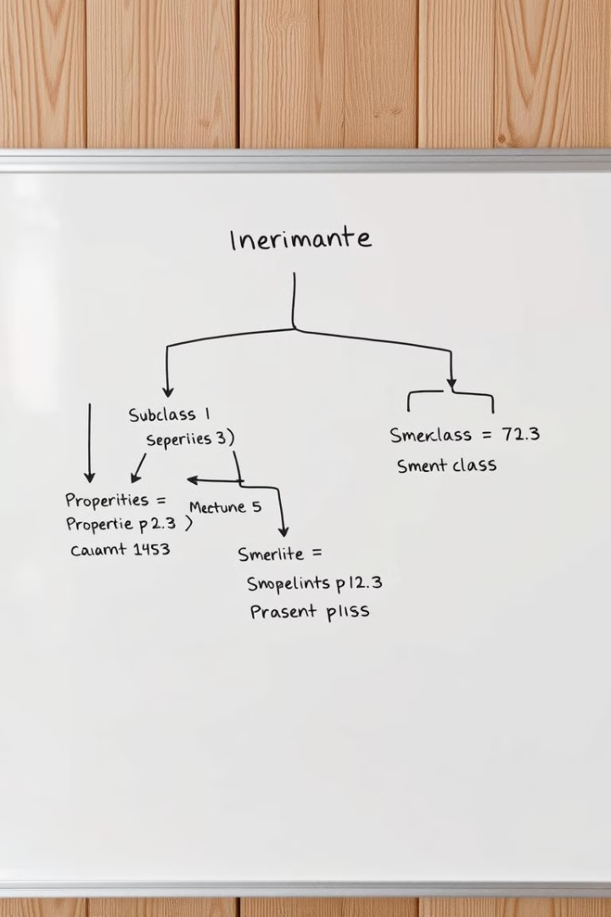


Inheritance and Polymorphism
Inheritance
The ability of a class to inherit properties and methods from its parent class, promoting code reusability.
Polymorphism
The ability of an object to take on multiple forms, allowing for flexible and adaptable code.

Slide 10

Encapsulation and Data Abstraction
Encapsulation
Data Abstraction
Wrapping data and methods within a single unit, restricting access to data from outside the class.
Hiding implementation details and providing a simplified interface for interacting with objects.

Slide 11

Real-World Examples of Arrays and OOP in Java
1
2
Apps
Games
Arrays are used to store and manage data in apps, while OOP helps structure code and make it reusable.
OOP principles are employed to model game objects and their interactions, while arrays store game data.

Slide 12
3
4
Graphical User Interfaces (GUIs):
Web Applications:
OOPs is a natural fit for building GUIs, where elements like windows, buttons, and menus are represented as objects. Java's Swing and JavaFX libraries heavily rely on OOPs concepts.
Java frameworks like Spring and Jakarta EE leverage OOPs principles to build robust and scalable web applications.

Slide 13
THANKYOU

